Slide 1




DIGITAL INTERNSHIP PROGRAM
PROJECT PRESENTATION
PROJECT NAME: INSURANCEBAZAR
10th March 2023

Slide 2

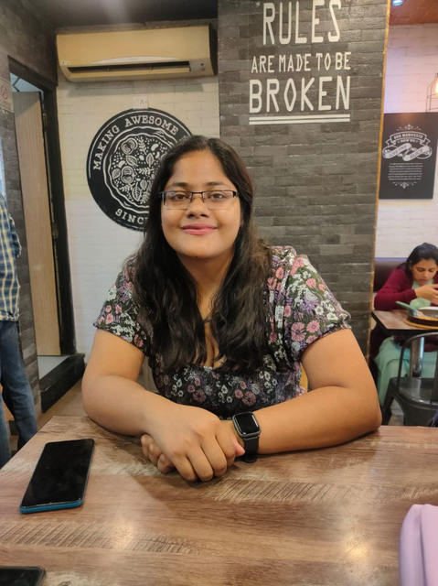

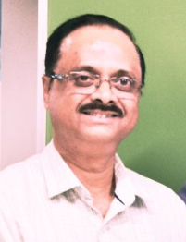
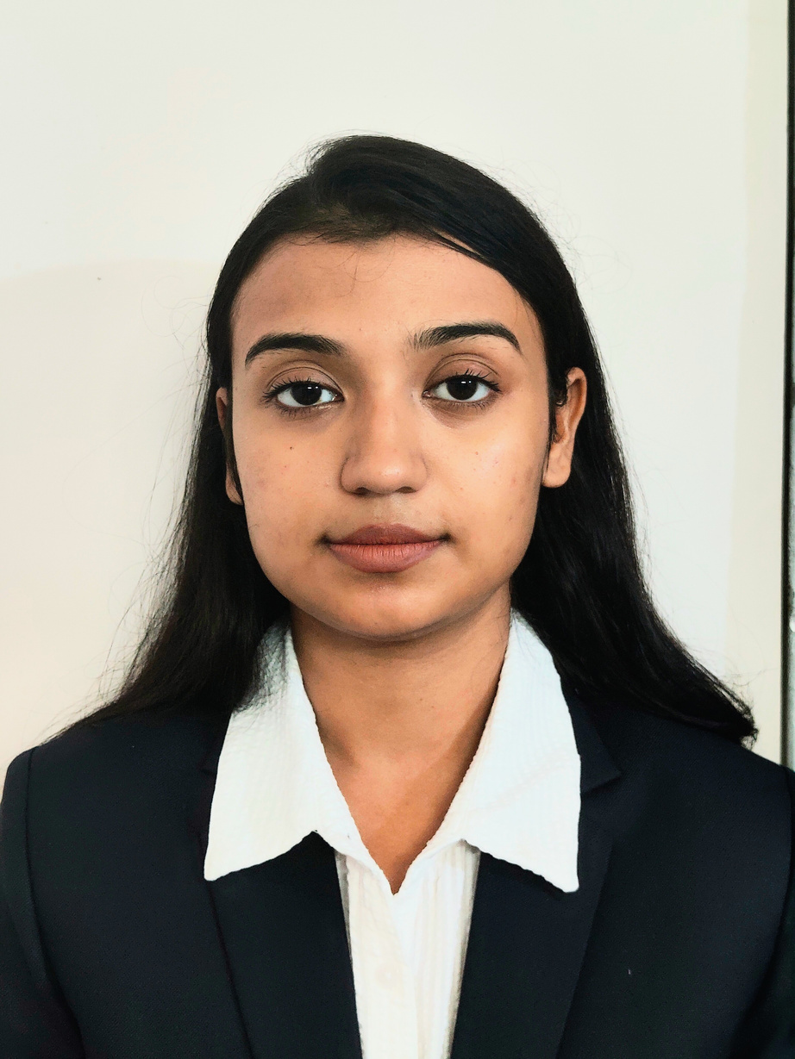


Group Members
We have completed this project under supervision and guidance of
Sagar Dey
Srabana Mukherjee
Ownkar Aman
A﻿vijit Chattopadhyay
Arpita Barua
Kaushiki Ghosh
Choudhury

Slide 3



1
Objective
2
Technologies Implemented
3
Technical Aspect Of Project
TABLE OF CONTENTS
4
Project and DB Architecture
Features and Best Industry Practices Followed
5
6
Future Scope
7
Development Issues and Solutions
8
Team Contributions
9
Disclaimer and Thank You

Slide 4


Objective
• By implementing several functionalities, the project team intends to exercise learning from Digital Internship Program.
We underwent a training for 6 weeks on Core Java, Enterprise Java Web Application Development using MVC Architecture [Struts2,Servlets,JSP, JSTL], Bootstrap CSS, JavaScript, REST API Development with SpringBoot [Controller, Model, Services],
AJAX and Database Concepts like Normalization, Aggregate Functions, Joins,Triggers
and Queries.
• At the end of the project, the team learned several aspects of project delivery like using central repository, version control, agile methodology for delivery and how to work in a collaborative enviroment.

Slide 5

Technologies Implemented
Core JAVA/EE
JDBC
MYSQL Server
Struts 2
We have used core Java/EE for Backend development.
JDBC is used for database
connection of our project.
My SQL is used to add, access, and process data stored in a Computer database.
We used Struts 2 to create well architectured applications.
SINGLE FEMALE
SINGLE MALE
Email Integration
MVC & Service Based Architecture
REST API
We have used to speed up the process of creating and updating task as well as replying to our customers.
It is use to implement the user interface and controlling logic.
Rest Api is used for getting data as Json object for verifying credentials.

Slide 6
Technologies Implemented
JQuery-AJAX
Bootstrap CSS,JSP,JSTL
Git & Github
JavaScript
Git is used to tracking changes in the source code, enabling team members to work together
JS allows developers to create a dynamic and interactive web pages and also enables us to load content into a document without reloading the entire page.
Ajax speeds up response time.is the method of exchanging data with a server, and updating parts of a web page, without reloading the entire page.
we have used bootstrap css to improve the styling of web pages
SINGLE FEMALE
SINGLE MALE
Apache Tomcat Server
Photoshop
Google Login
chart.js
It is used for
authentication
purpose.
It is also often used as single sign in for third party services.
Chart.js is a JavaScript Graph which was used of getting analysis of our various data in form of representational graphs.
apache tomcat is responsible to provide a run-time environment for the servlets. It provides an environment in which one could run their java code.
Create a attractive images

Slide 7

Technical Aspect Of Project
∙ We decided to build an Insurance web application with features like Responsive
front-end(Bootstrap, CSS, JS ), integrated MySQL database(through JDBC), displaying dynamic content as per role, Email Integration and 3rd Party REST API & JSON integration ( for data validation).
∙ We used GitHub for version control and central repository.
∙ Retrieval and display of dynamic content was achieved using Struts Framework and JSTL.
∙ Implemented Email Integration using Gmail SMTP Server from the JAVAMail Web API.
∙ Used Chart.Js to depict dynamic graphical representaion of data.
∙ Wrike as agile tool.

Slide 8
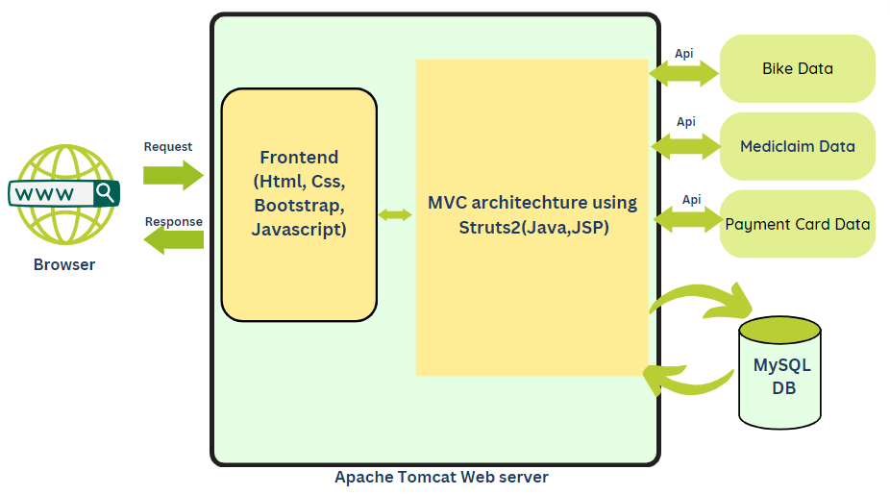
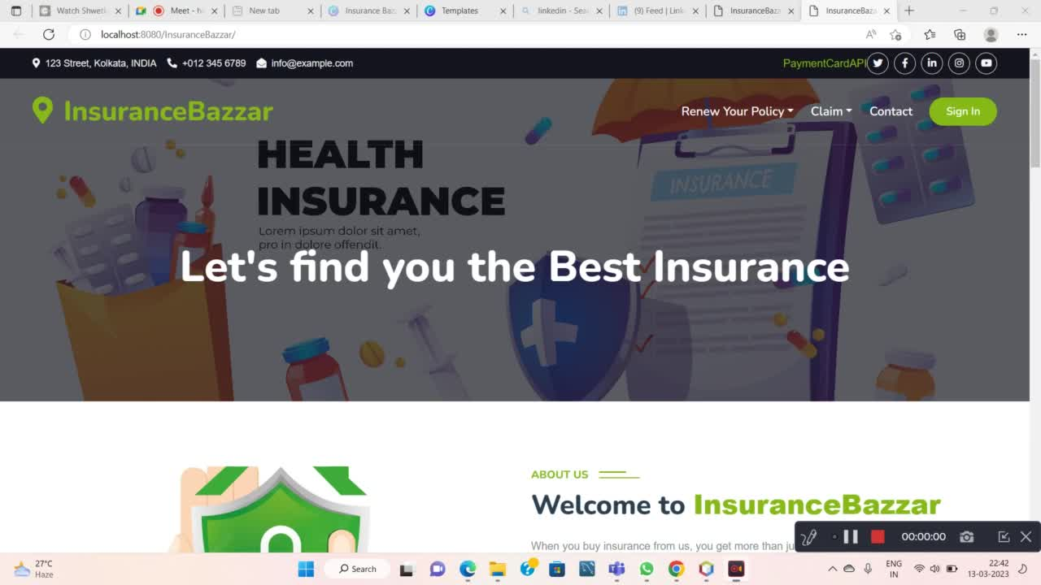


Project Architecture
Preview
User

Slide 9
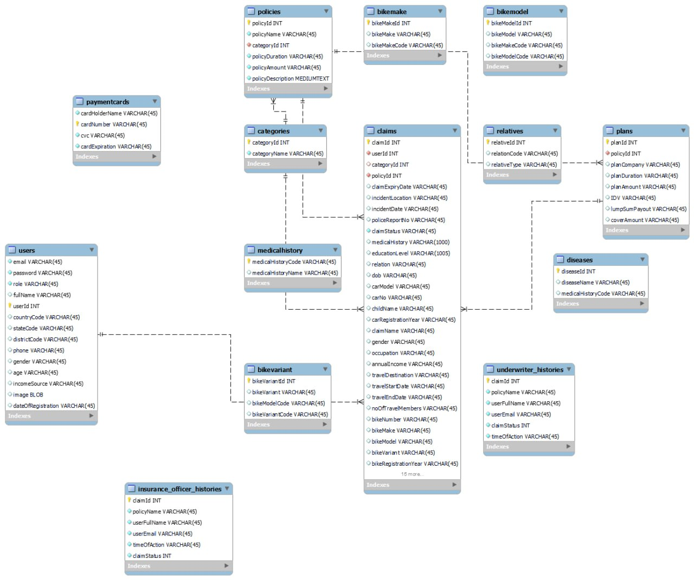
Database Design

Slide 10

Features:
• Role based Login (Customer, Underwriter, Insurance Officer)
• Authentication implemented- No unauthorized access
•Social media login achieved using Google account by storing the Google id as password
Customer Signup
• Customer Dashboard consisting of Customer Profile; Available Insurance Policies;My Policies ; Ability to File a Claim; Purchase the Policy and make a Payment.
• Underwriter’s Dashboard, management of claims like verification and also their approval and rejection.
• Insurance Officer’s dashboard, sanctioning of claims after underwriter’sapproval.
• Underwriter’s and Insurance Officer’s Dashboard have a record of the number of customer registered, and number of policies bought as per last 5 days , represented by a graph.
We will be elaborating on each of these actions in the following slides

Slide 11









Customer Features:
Login/SignUp
Payment
Claim Cover
Amount/File Fnol
Download Pdf
View Claim Details
Update Profile
Buy policy
Email Recieved
Logout

Slide 12
Customer Features Cont..
•Regex implemented in password section of signup and password & confirm password matching validation
•In user profile page, customer updates image, full name, gender, age, occupation type and front-end validation implemented in every field.
•Customer can see policies and buy policy after proper front-end form validation. Customer can also see plans corresponding to the policy he is going to buy.
•Fake payment implemented for the customer to pay for the policy and payment card details are validated with a REST API . Once payment done he will be redirected to download an invoice of the policy he bought.
•Customer can navigate to his dashboard to view the plans bought by him.
•Customer can file an FNOL in case of an accident or can get his cover amount during any medical emergency.
•While filing an FNOL, proper validations for incident date, police report number format are taken care of. Customer will be updated regarding the status of his claim.
•JQuery AJAX implemeted throughout the customer dashboard page.

Slide 13
Customer Features Cont..
In our project we have implemented two policies: Bike Insurance and Health Insurance.
Implementation of Bike Insurance Functionalities:
Customer fills a form with details like Bike Number, Bike Make, Bike Model, Bike Registration Year before he is going to buy the policy. Each of these fields are mandatory to fill. Bike Number is validated with proper format so no junk data enters the database. Bike models are populated dynamically based on the bike makes- functionality acheived by AJAX.
Other details of the customer like name, email, age gender etc are populated from session.
Once the customer buys bike insurance, he can file first notice of loss or FNOL(one time)in case he met with an accident.
The FNOL form contains auto filled fields corresponding to the bike details he filled up earlier and is asked to fill in new details.
Each of these fields are again compulsory to fill with proper validation being applied to the accident date i.e. accident date cannot go beyond current date and also proper police report number is mandated. The above functionalities are acheived using JavaScirpt.
Once he files FNOL, he will be notified regarding the status of his claim.

Slide 14
Customer Features Cont..
Implementation of Health Insurance Functionalities:
Customer can buy health insurance for himself, and also for his family members like his spouse, father, mother, son, daughter.
In case he is buying the insurance for his family members, extra fields like name, age, adhar card number of that family member are brought to the form to be filled by him, with the help of AJAX. Also, proper age validation in case each of the family members is taken care of.
In case he is buying it for himself no such extra fields appear since details like his name, age, gender etc. are populated from session.
Once the customer buys health insurance, he can claim for his cover amount during medical emergency.
The form to claim the amount is populated with the data he already filled up while he was buying the insurance.
Customer can claim for the amount only once, corresponding to the policy he bought.
Once he files the claim, he will be notified regarding the status of his claim.

Slide 15





Underwriter Features:
Login
Approve Claim
View History
View Pending Claims
Reject Claim
View Chart
Verify Details using API data
Rejection Email Sent
Logout

Slide 16

Underwriter Features Cont..
•Underwriter can view different categories, each having two policies.
Whenever he clicks on a policy, he is redirected to show a scrollable table of pending claims corresponding to that policy.
• Underwriter verifies the claim details on background provided by the customer. Verification is done on the basis of data provided by Rest API calls.
•Underwriter can approve or reject the claim after verification.
•In case of rejection a rejection mail is sent.
•jQuery AJAX implemented throughout the underwriter dashboard page.
•Graph shown in landing page depicts the number of users registered to the website and number of policies bought in the last 5 days.

Slide 17

Insurance Officer Features:
Login
Sanction Email Sent
View Approved Claims
View Chart
View History
Sanction Policy Amount
Logout

Slide 18

Insurance Officer Features Cont..
• Insurance Officer can view different categories, each having two policies. Whenever he clicks on a policy, he is redirected to show a table of claims approved by the underwriter.
• Insurance Officer sanctions the policy amount.
• Success email will be sent to the customer.
• jQuery AJAX implemented throughout the insurance officer dashboard page.

Slide 19
PMD Implementation
PMD is a source code analyzer to identify potential bugs and common programming flaws like unused variables, empty catch blocks, unnecessary object creation etc. by analyzing the source code.
Steps to use the PMD Static Code Analyzer :-
Installed the PMD Static Code Analyzer on the local machine.(https://pmd.github.io/latest/pmd_userdocs_installation.html#how-to-install-pmd-and-cpd)
Next, run the PMD analyzer on the target code base, specifying the ruleset that they have selected.
After analysis is completed, the PMD analysis report was reviewed to identify any issues detected in the code.
The issues found by PMD was analyzed and prioritized based on their severity and impact on the codebase and were resolved accordingly. To ensure code quality is maintained overtime, the PMD analysis was repeated periodically.

Slide 20
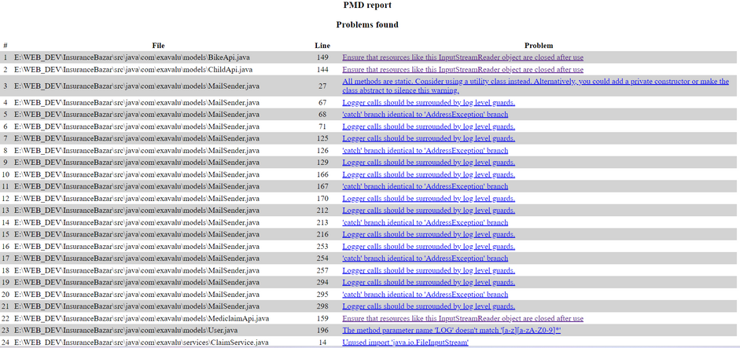
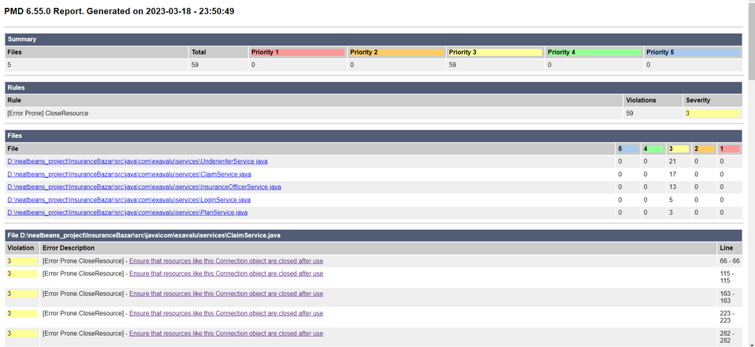
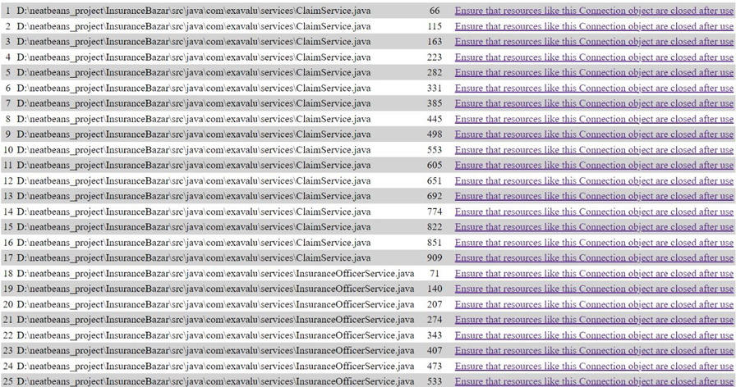
PMD Implementation Cont...
Day 1
435 wanings
Day2
312 warning
Day3
59 warnings

Slide 21
Best Industry Practices Followed
01
Proper naming convention for Java Class, Variables, Functions.
06
Proper Commenting with JavaDoc Annotations.
02
Reusability and Code Modularization.
07
Email Integration and implementation of AJAX
03
Proper Error Tracking & Logging (Log4J).
08
Consumption of 3rd Party Rest API data & JSON.
04
Effective Memory Management (Singleton Classes).
09
Implementation of PMD and MD5 encryption algorithm.
05
Property files for Application Global Variables.

Slide 22

Future Scope:
Apple Login /Facebook Login
Live Payment processing.
Database storage for Images.
Conversion to RESTful Web Services.

Slide 23

Development Issues and Solutions
Issues
Solutions
•Setting up Struts2.
•Overlapping of proposed CSS styling due to implementation of AJAX.
•Email filled with spam after email integration
•Session Map issues
•Multiple updations to Database tables
•Github(conflict)
•Gone through various docs in google
•Watched various videos
•Made our repository private.
•Added inline Css to fix the Ajax styling problem

Slide 24

Team Contributions:
Arpita Barua:
View:landingpage, signup, login, forget password, user home page, user dashboard, user profile, two wheeler policy, mediclaim, travel, child, vehicle fnol, health claim, plans, payment.
Model: User, Plan
Service: LoginService,PlanService
Extra:Database-creation,Asynchronous-Javascript Fetch API, Log4j implementation, document & ppt preperation,github control,photoshop
Kaushiki GhoshChoudhury:
View: landing page, signup, login, forget password, user home page, user dashboard, user profile, two wheeler policy, Mediclaim, travel, child, vehicle fnol, health claim, plans, payment, underwriter home page.
Model: User, Plan
Service: LoginService, PlanService
Extra: Database-Creation, Asynchronous-Javascript Fetch API ,Ajax in login and signup views,Log4j implementation, hardcoded chart.js, document & ppt preperation, github control.
Srabana Mukherjee:
View: signup, user profile, two wheeler policy, ajax page, mediclaimPoliy, ajax relatives page, ajax disease list page, vehicle fnol, health claim, plans page, payment page, bought plans page
Model: Claim, Plan, BikeModel, Disease, Relative, Payment Card
Service: LoginService,ClaimService,PlanService
Extra: Front-end validation, Asynchronous Javascript Fetch API, Regex password, AJAX in dynamic dropdowns and form fields, user view, authentication, REST API, Database Creation, document & ppt preperation, github control.
Sagar Dey:
View: Pending mediclaim list, pending two wheeler claim list, approved mediclaim list, approved two wheeler claim list, approved child claim list, approved travel list, claim med content, claim bike content, bike api data, med api data, user profile
Model: Claim, BikeApi, MediclaimApi, InsuranceOfficerHistory, UnderwriterHistory, MailSender
Service: Underwriter Service,Insurance Officer Service,LoginService,ClaimService
Extra: Email integration, Google Login,Image upload to database, chart.js-backend integration, REST API, Database Creation, AJAX in underwriter and insurance officer page, wrike update, document & ppt preperation, github control.
Ownkar Aman:
View: underwriter home page, pending mediclaim list, pending two wheeler claim list, pending child claim list, pending travel list, underwriter history page, insurance officer home page,approved mediclaim list, approved two wheeler claim list, approved child claim list, approved travel list, insurance officer history page, API call design
Model: User, BikeApi, MediclaimApi
Service:
LoginService,Underwriter Service,Insurance Officer Service
Extra: Database Creation, AJAX in underwriter and insurance officer page, hardcoded chart.js, document & ppt preperation, document & ppt preperation, github control,scrollable table.

Slide 25


Disclaimer:
Design and Functionality:
•https://www.policybazaar.com
Template:
•https://codepen.io/trending
•https://colorlib.com/
•https://www.cssscript.com
Generation of REST API:
•https://mocki.io/
•https://retool.com/api-generator/

Slide 26



Proceed to demo

